Slide 1
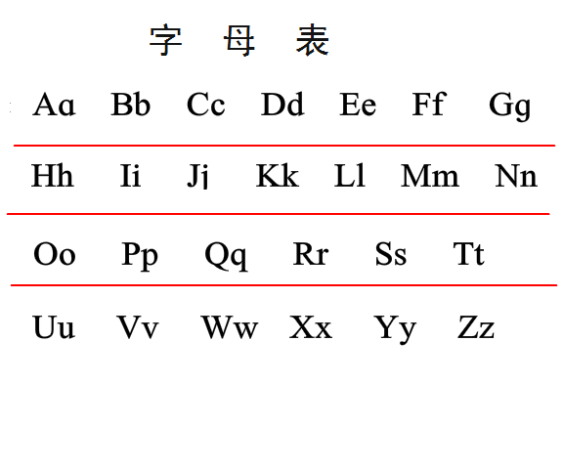
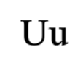

Slide 2
Aa = ah Bb = Bob Cc = bits cheese Dd = Door
Ee = elephant or errrr Ff = far Gg = google Hh = hey
Jj = jeep Kk = book Ll = light Mm = Mum
Nn = nurse Oo = ouch Pp = pop Qq = cheese
Rr = measure or raw Ss = Sir Tt = Tea Wu = what
Xx = Sheep Yy / i = easy Zz = Zoo

