Slide 1
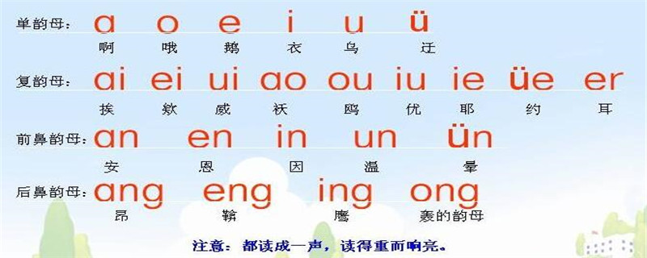

Slide 2
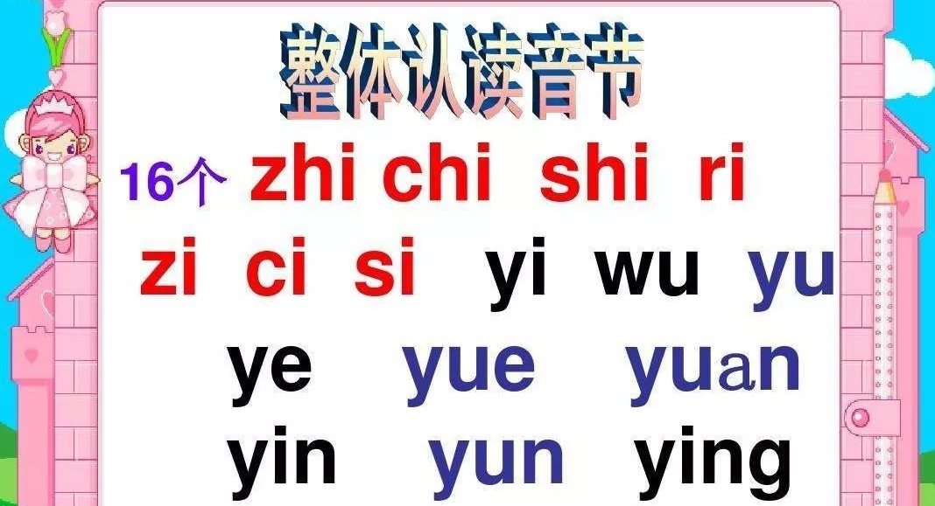
ji = jeep
qi = cheap
xi = sheep
zi = adds
ci = bits
si = s tongue pressed more forward
zhi = adjure
chi = chirp
shi = shirt
ri = measure

Slide 3
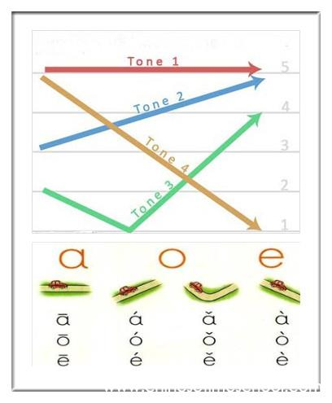
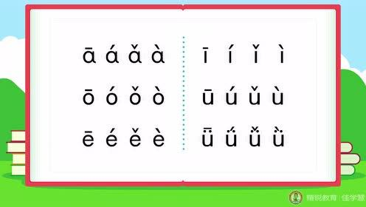
Tone 1 like when you happy and shout out “yeeee”
Tone 2 when you make a question “really? What?”
Tone 3 has two part go down then up like “done it / have it”
Tone 4 when you answer a question with yes or no.

Slide 4
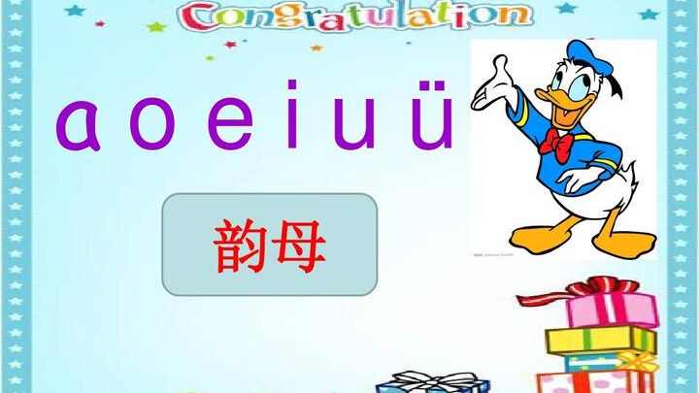

Slide 5
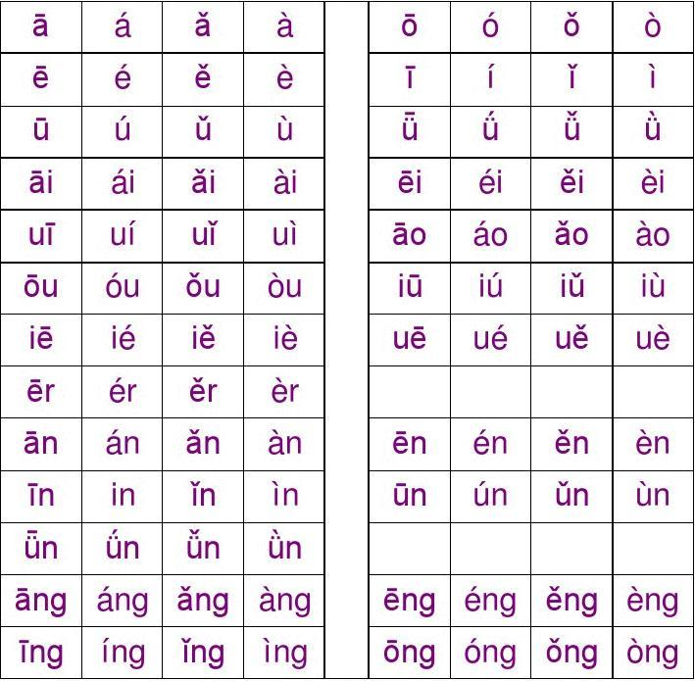

Slide 6
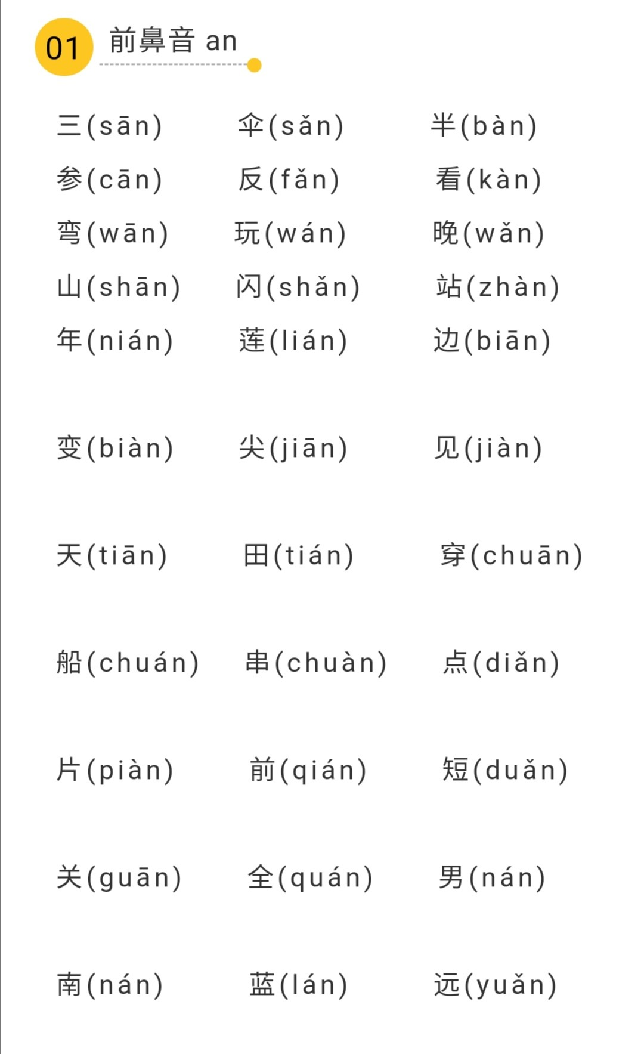

Slide 7
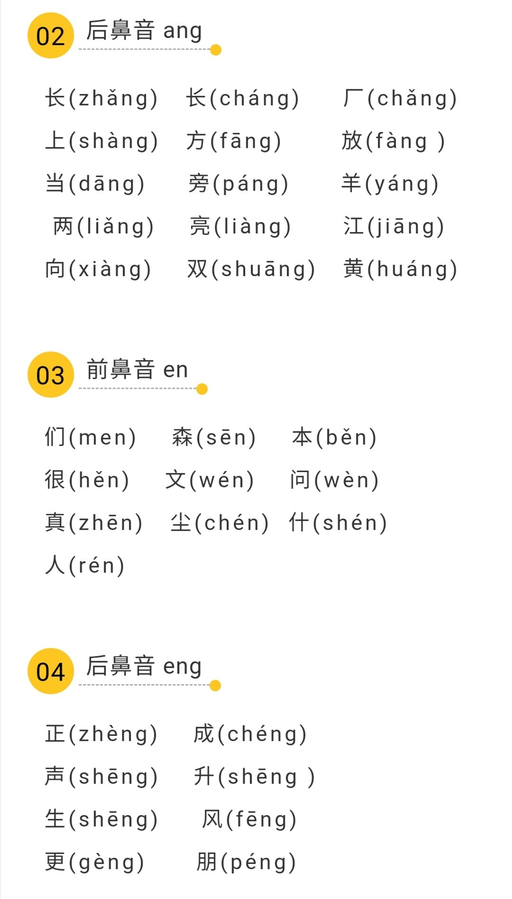

Slide 8
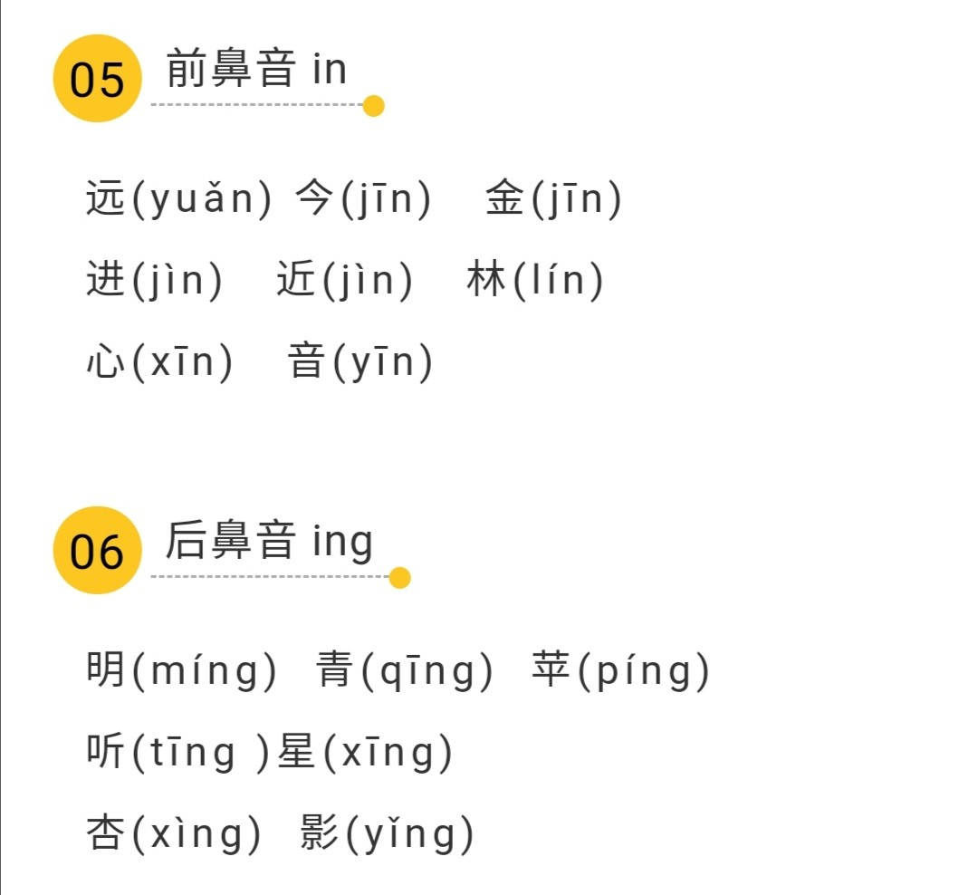

Slide 9
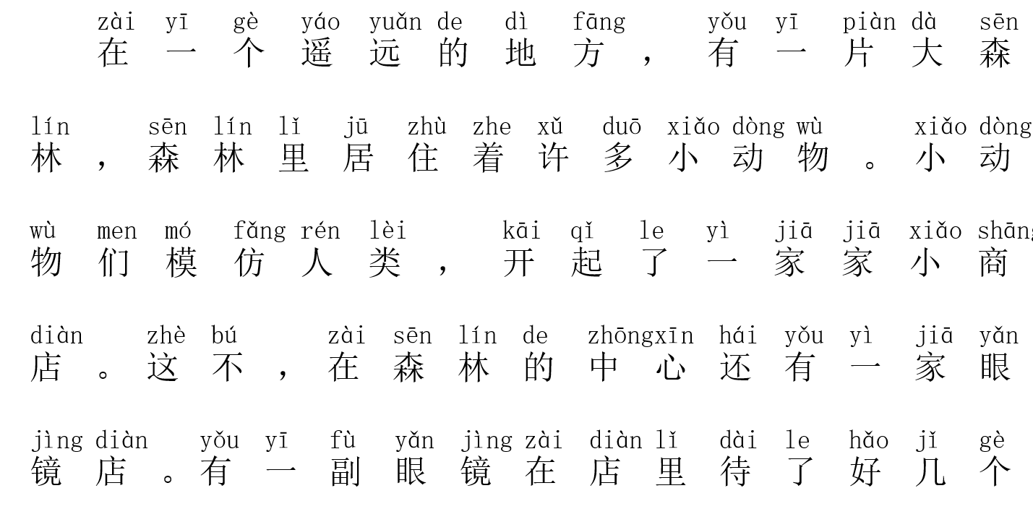

Slide 10
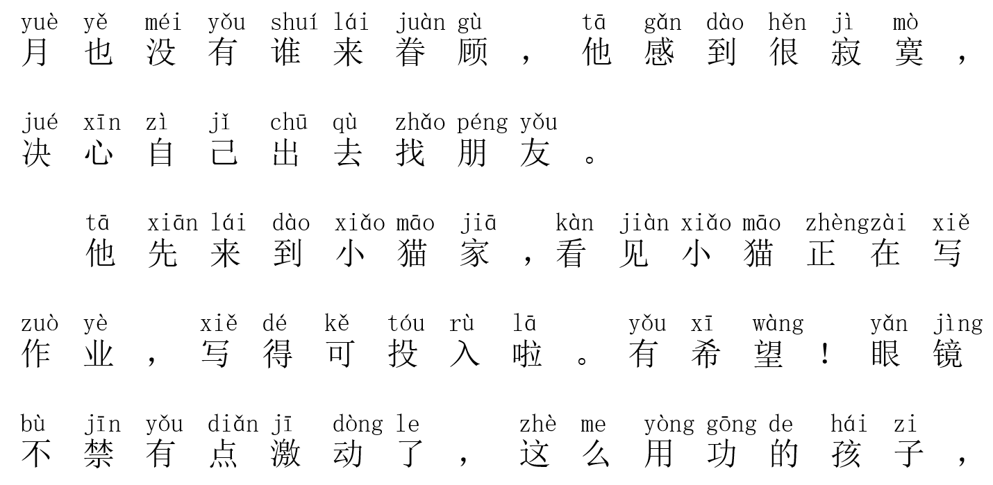

Slide 11
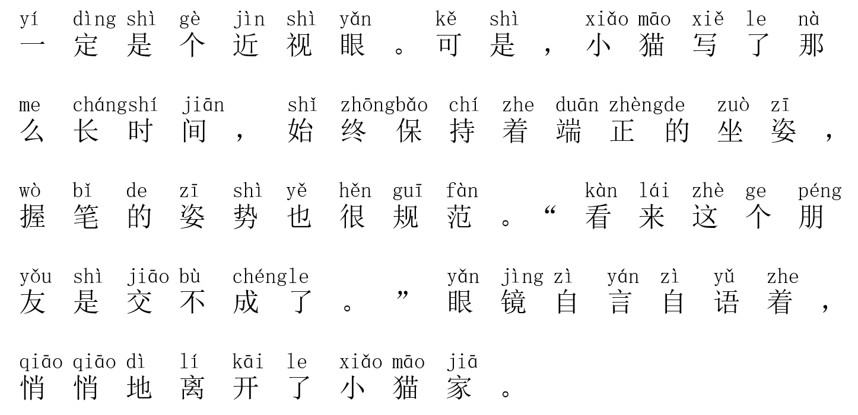

Slide 12
