Slide 1
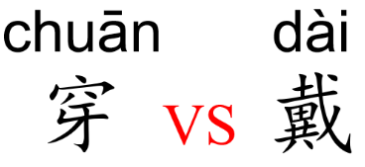
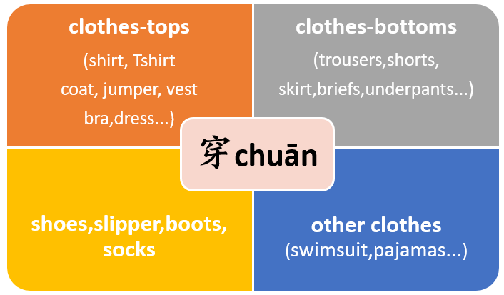
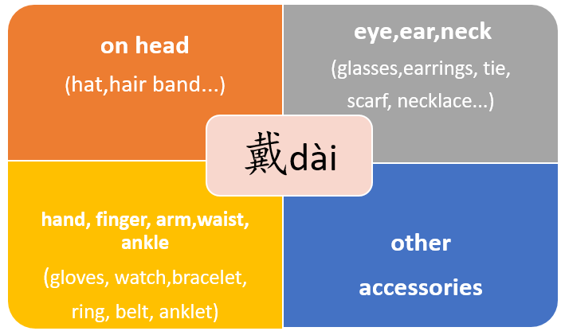
穿chuān and 戴 dài both mean “to wear; to put on”. But put on the different body part you need to choose different verb.
穿 chuān is used for wearing clothing such as tops, bottoms, shoes and socks. Basically all clothing is worn by putting your body, arms or legs. But does not include any accessories.
In addition to meaning “to wear”, it also means “to pierce and to go through”.
戴 dài is a verb used for Putting things or accessories on the head, face, neck, chest, arms, etc.

